Slide 1

Data Science in Retail and E-Commerce
Presented By :- SNEHAL TAWAR

Slide 2
Contents:
1. Data Science Life Cycle
2. How Data Science is Used in Retail and e-Commerce
a) Recommendation System
b) Customer Lifetime Value Modelling
c) Customer Retention- Churn Model
d) Fraud Detection
e) Important Reviews- Improved Customer Service
3. Summary
4. References

Slide 3
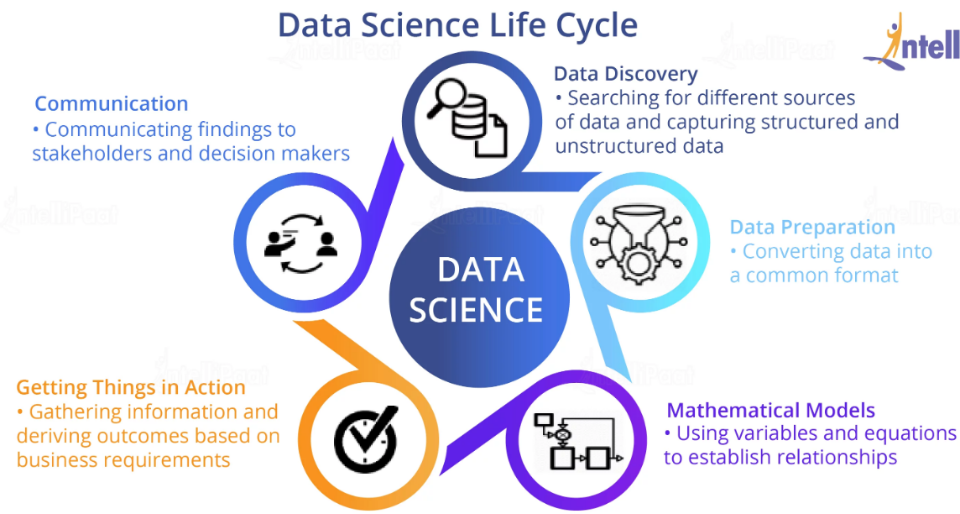

Slide 4

How Data Science is Used in Retail and e-Commerce
Recommendation engines
Market Basket Analysis
Warranty Analytics
Price Optimization
Inventory Management
Location of new stores
Customer sentiment analysis
Merchandising
Lifetime value prediction

Slide 5
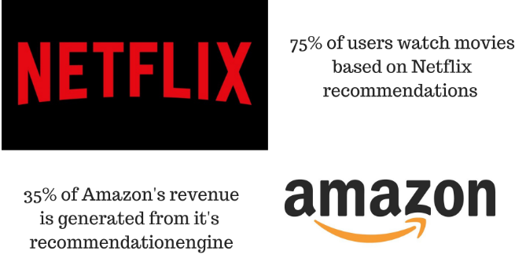
1. Recommendation System
Used to filter choices for particular user on the basis of their past searches or other customer’s search or purchase data. It gives users a personalized view on the eCommerce website and help them to select relevant products. Popular Recommendation Techniques:
Collaborative filtering
Content Based Filtering
Hybrid Recommendation Filtering

Slide 6
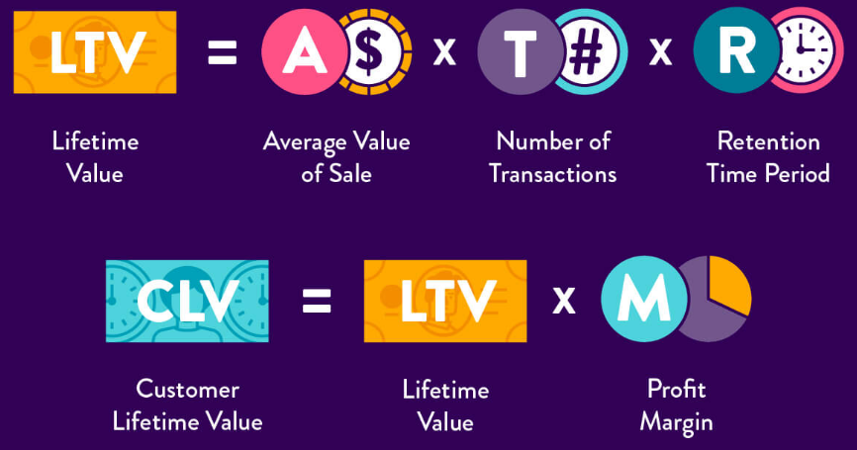
2. Customer Lifetime Value Modelling
Customer lifetime value is a prediction of the net profit attributed to the entire future relationship with a customer.

Slide 7

CLV helps eCommerce businesses in many ways -
Defining objectives for the company- growth, expenditures, future sales, net profit etc.
Optimize business marketing strategies.
Adjusting campaign and advertisement.
Decide cross sell and up sell according to customer’s purchase.
CLV helps to decide customer acquisition cost, the cost of attracting customers.

Slide 8
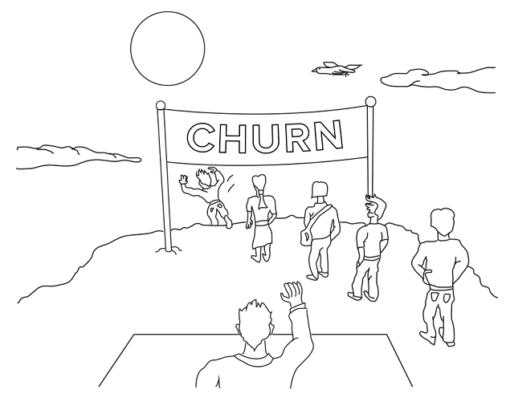
3. Customer Retention- Churn Model
Churn Model helps identifying customers who are most likely to switch to different eCommerce website.
Customer retention refers to the ability of a company or product to retain its customers over some specified period.
Few common metrics are –
Number of customers lost
Percent of customers lost
Value of recurring business lost
Percent of recurring value lost

Slide 9

4. Fraud Detection
Fraud is a billion-dollar business and it is increasing every year.
The PwC global economic crime survey of 2016 suggests that more than one in three (36%) of organizations experienced economic crime.
There are a number of ways a fraud can happen online -
Identity theft
Chargeback fraud
Friendly fraud
Clean fraud
Triangulation fraud
Affiliate fraud
Merchant identity fraud
Advanced fee and wire transfer scams

Slide 10

5. Important Reviews- Improved Customer Service
These days companies especially online businesses, have ratings and reviews section on their websites for their products.
Using Data Science techniques e.g NLP(Natural Language Processing) the ratings and reviews from the website, can be extracted. This technique helps to retrieve user reviews and understand why bad reviews were given.
Once the reviews are extracted, Data Scientists can further segregate them and do Sentiment Analysis. With this information, eCommerce can efficiently maximize user satisfaction by prioritizing product updates that will have the greatest positive impact.

Slide 11

Summary
Big Data is Used to Spot the Next Big Trend
Crunching Numbers to Get the Right Products in Front of the Right Customers: The data is increasing with every single click on the internet. In order to make sense of this huge data and use it for company’s benefits etc, we need help from different Data Science techniques. The Challenge of In-Store Data Collection. With Location-based Advertising, Products Find the Customer
Timing is Everything … The Right Price at the Right Time: Opening the Valve on Data-Optimized Pricing

Slide 12
References
https://towardsdatascience.com/5-data-science-project-every-e-commerce-company-should-do-8746c5ab4604
https://analyticsindiamag.com/10-data-science-projects-most-e-commerce-businesses-are-using-in-india/
https://www.datasciencegraduateprograms.com/retail/
https://www.greatlearning.in/blog/applications-of-data-science-in-e-commerce-industry/
https://www.wikipedia.com/

Slide 13

THANK YOU

